Slide 1
Predicting Customer Subscription Likelihood
An Optimized Classification Model with Feature-Importance Analysis
Task 9 — Mini Project 5 | Eswar – G40 AI & ML

Slide 2
The Business Problem
1
Attracting visitors is easy — converting them into loyal, repeat customers is hard.
2
The company wants to identify which customers are likely to become subscribed, engaged, repeat purchasers.
3
Accurate prediction lets the business prioritize retention offers and stop wasting spend on unlikely candidates.
"Based on customer behaviour and profile information, can we predict who is likely to become a loyal, subscribed customer?"

Slide 3
Dataset Overview
ecommerce_customer_data.csv
3,900
18
0
73% / 27%
Customer records
Original columns
Missing values
No / Yes subscription split
Target variable adaptation:
The brief describes a Purchase (Yes/No) target with browsing-session fields. The data actually supplied has no such flag — every row is already a completed transaction. Subscription Status (Yes/No) is used instead as the closest genuinely binary, business-meaningful outcome: loyal/engaged customers vs. one-off shoppers.
Identifiers such as Customer ID were dropped before modelling; Promo Code Used was dropped as a 100%-duplicate of Discount Applied.

Slide 4
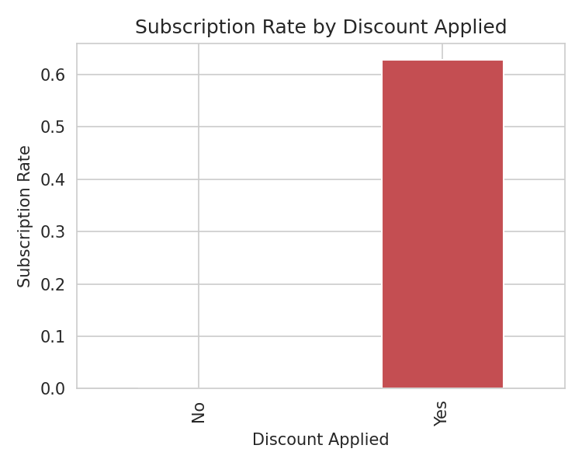
Exploratory Findings
Customers who received a discount are far more likely to be subscribed than those who did not.
Every subscribed customer in this dataset is male — flagged as a likely data artifact, not a real business signal.
Previous purchases and purchase amount show only modest differences between subscribers and non-subscribers.
Numerical features (age, amount, rating, previous purchases) are only weakly correlated with each other.

Slide 5
Preprocessing Approach
Numerical Features
Categorical Features
Split Strategy
Age, Purchase Amount,
Review Rating,
Previous Purchases
→ Median imputation
→ Standard scaling
Gender, Category, Location,
Size, Color, Season,
Shipping Type, Payment Method,
Discount Applied, etc.
→ Most-frequent imputation
→ One-hot encoding
80% train / 20% test
Stratified by target
to preserve the
73/27 class balance
in both sets
All transformations are fit only on the training set and wrapped in a single scikit-learn Pipeline to prevent data leakage.

Slide 6
Models Compared
Baseline performance on the held-out test set
Model | Accuracy | Precision | Recall | F1-Score | ROC-AUC
Logistic Regression | 0.854 | 0.686 | 0.848 | 0.758 | 0.910
Decision Tree | 0.791 | 0.635 | 0.536 | 0.581 | 0.711
Random Forest | 0.844 | 0.663 | 0.858 | 0.748 | 0.907
Logistic Regression and Random Forest clearly outperform a single Decision Tree, which overfits and generalizes worse on unseen customers.
Metric selected for optimization: F1-score — it balances not wasting spend on unlikely customers (precision) against not missing real subscribers (recall).

Slide 7
Hyperparameter Optimization
5-fold GridSearchCV, scored on F1 — test set untouched during search
Logistic Regression
Random Forest
Best parameters:
C = 0.01
penalty = l2
class_weight = balanced
Best CV F1-score: 0.765
Best parameters:
n_estimators = 100
max_depth = 10
min_samples_split = 2
class_weight = balanced
Best CV F1-score: 0.765
Sensitivity analysis showed Random Forest's cross-validated F1 flattens well before unlimited tree depth, and Logistic Regression's F1 is stable across a wide range of C — guiding these choices.

Slide 8
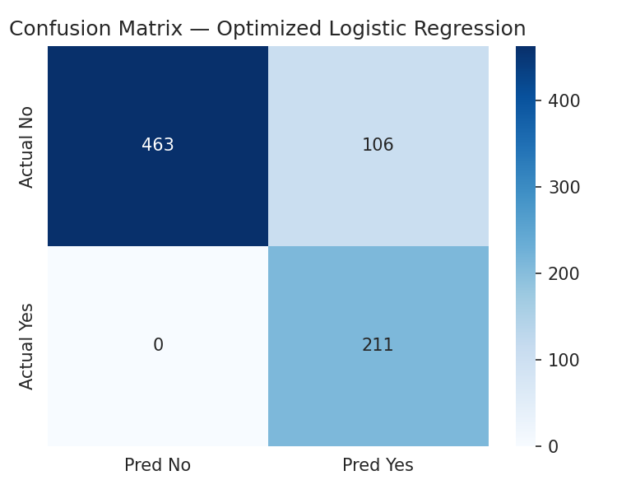
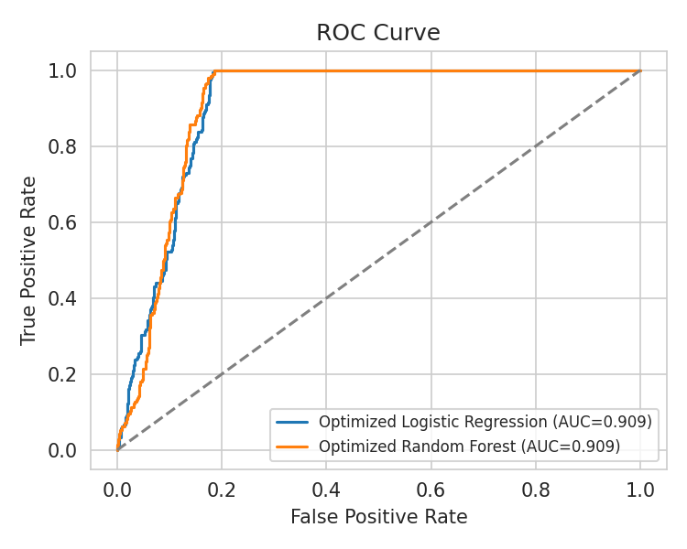
Final Model Performance
Optimized Logistic Regression selected as the final model
86.4%
Accuracy
0.799
F1-Score
0.909
ROC-AUC
Optimization raised F1-score from 0.758 (baseline Logistic Regression) to 0.799 — mainly by better handling the 73/27 class imbalance via class_weight and regularization tuning.

Slide 9
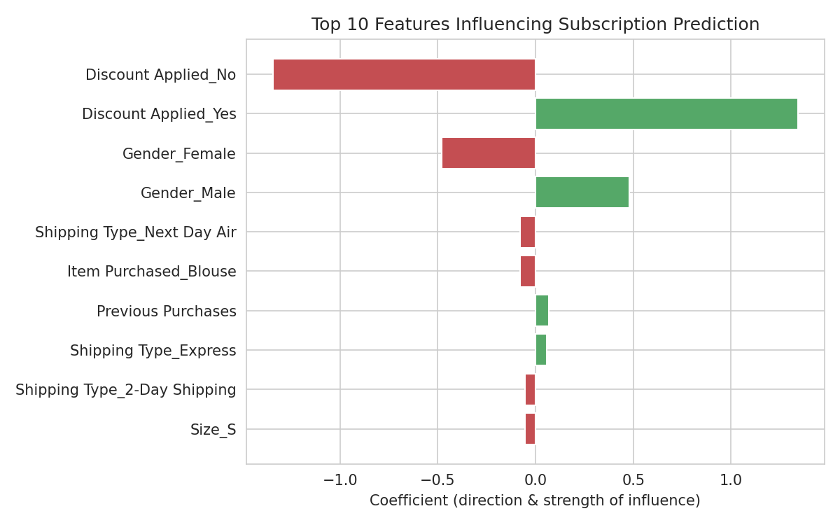
Feature Importance
Discount Applied
Strongest predictor by far — discounted customers are much more likely to be subscribed.
Gender
Second strongest, but likely a dataset artifact — do not use for real targeting without validation.
Previous Purchases
More past purchases modestly raise predicted subscription likelihood.
Importance reflects association, not proven causation.

Slide 10
Business Recommendations
1
Bundle discounts into subscription sign-up and win-back offers.
2
Do NOT target on gender — validate the effect on real, current data first.
3
Prioritize the High-likelihood segment for premium loyalty offers.
4
Adopt the optimized pipeline as the production scoring model.
5
Set the classification threshold to match real campaign economics, not the 0.50 default.

Slide 11
Limitations & Next Steps
Limitations
Next Steps
• Subscription Status is a proxy target — the source data has no literal purchase/no-purchase or browsing-session field
• The dominant Gender effect looks like a data-generation artifact, not a real pattern
• Results come from a single static extract of 3,900 customers
• Feature importance shows association, not proven causation
• Validate the Gender/Discount patterns against current, real customer data before acting
• Monitor model performance and retrain as new data arrives
• A/B test the discount-bundling and segment-based offer recommendations
• Tune the classification threshold with input from marketing and finance on real campaign costs

